Slide 1
Encrypted Client Hello
An all-in-one presentation
Georgios Tasopoulos (g.tasop@isi.gr)
Evangelos Haleplidis (haleplidis@isi.gr)
Apostolos Fournaris (fournaris@isi.gr)

Slide 2
TLS 1.3

Slide 3
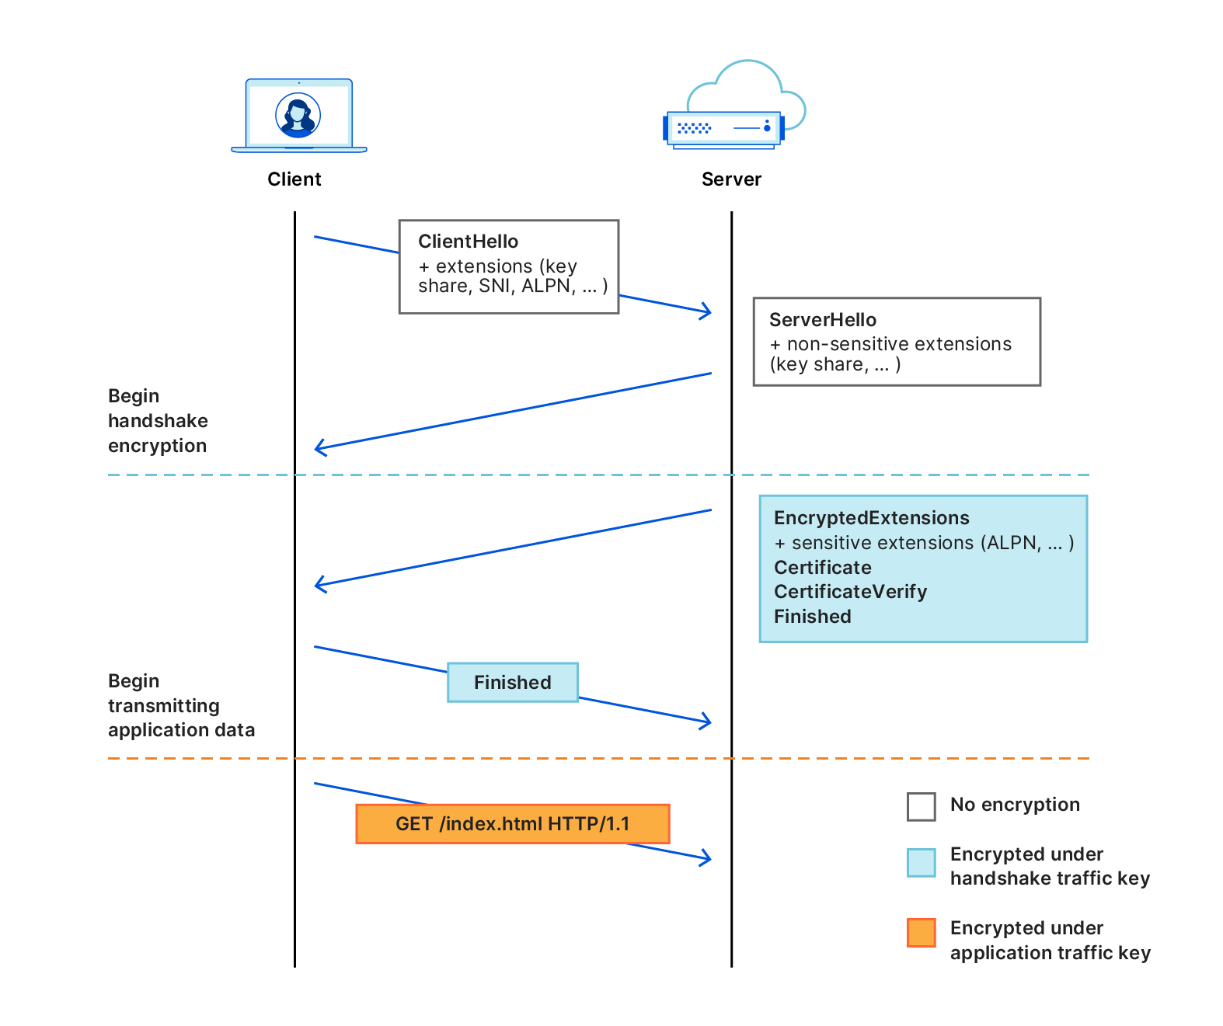
TLS 1.3
The de-facto standard for secure communications
Client Hello initiates the handshake (illustrated TLS 1.3)
Unfortunately some fields (extensions) remain unencrypted which contain sensitive information
Server Name Indication Extension (SNI)
Application-Layer Protocol Negotiation Extension (ALPN)

Slide 4
ECH Extension

Slide 5
ECH Extension
Sensitive unencrypted extensions
Server Name Indication Extension (SNI)
Application-Layer Protocol Negotiation Extension (ALPN)
ECH (an IETF draft) is aiming to encrypt these extension before sending them to the server
“the goal of ECH is to encrypt all handshake parameters except those that are essential to completing the key exchange”
The issue is…How is this achieved if the client sends the first message?

Slide 6
ECH Extension
In order to achieve this, ECH relies on DNS records
Together with the standard DNS query, the client requests for a TXT record with the ECH configuration (incl. Public key)
This can be considered safe if DNS-over-HTTPS is used!
It adds up to that and provides improvements to some known key distribution issues
We are NOT going to use DNS in our examples; we will provide the client with fresh configs from the server assuming that it could get those from DNS records

Slide 7
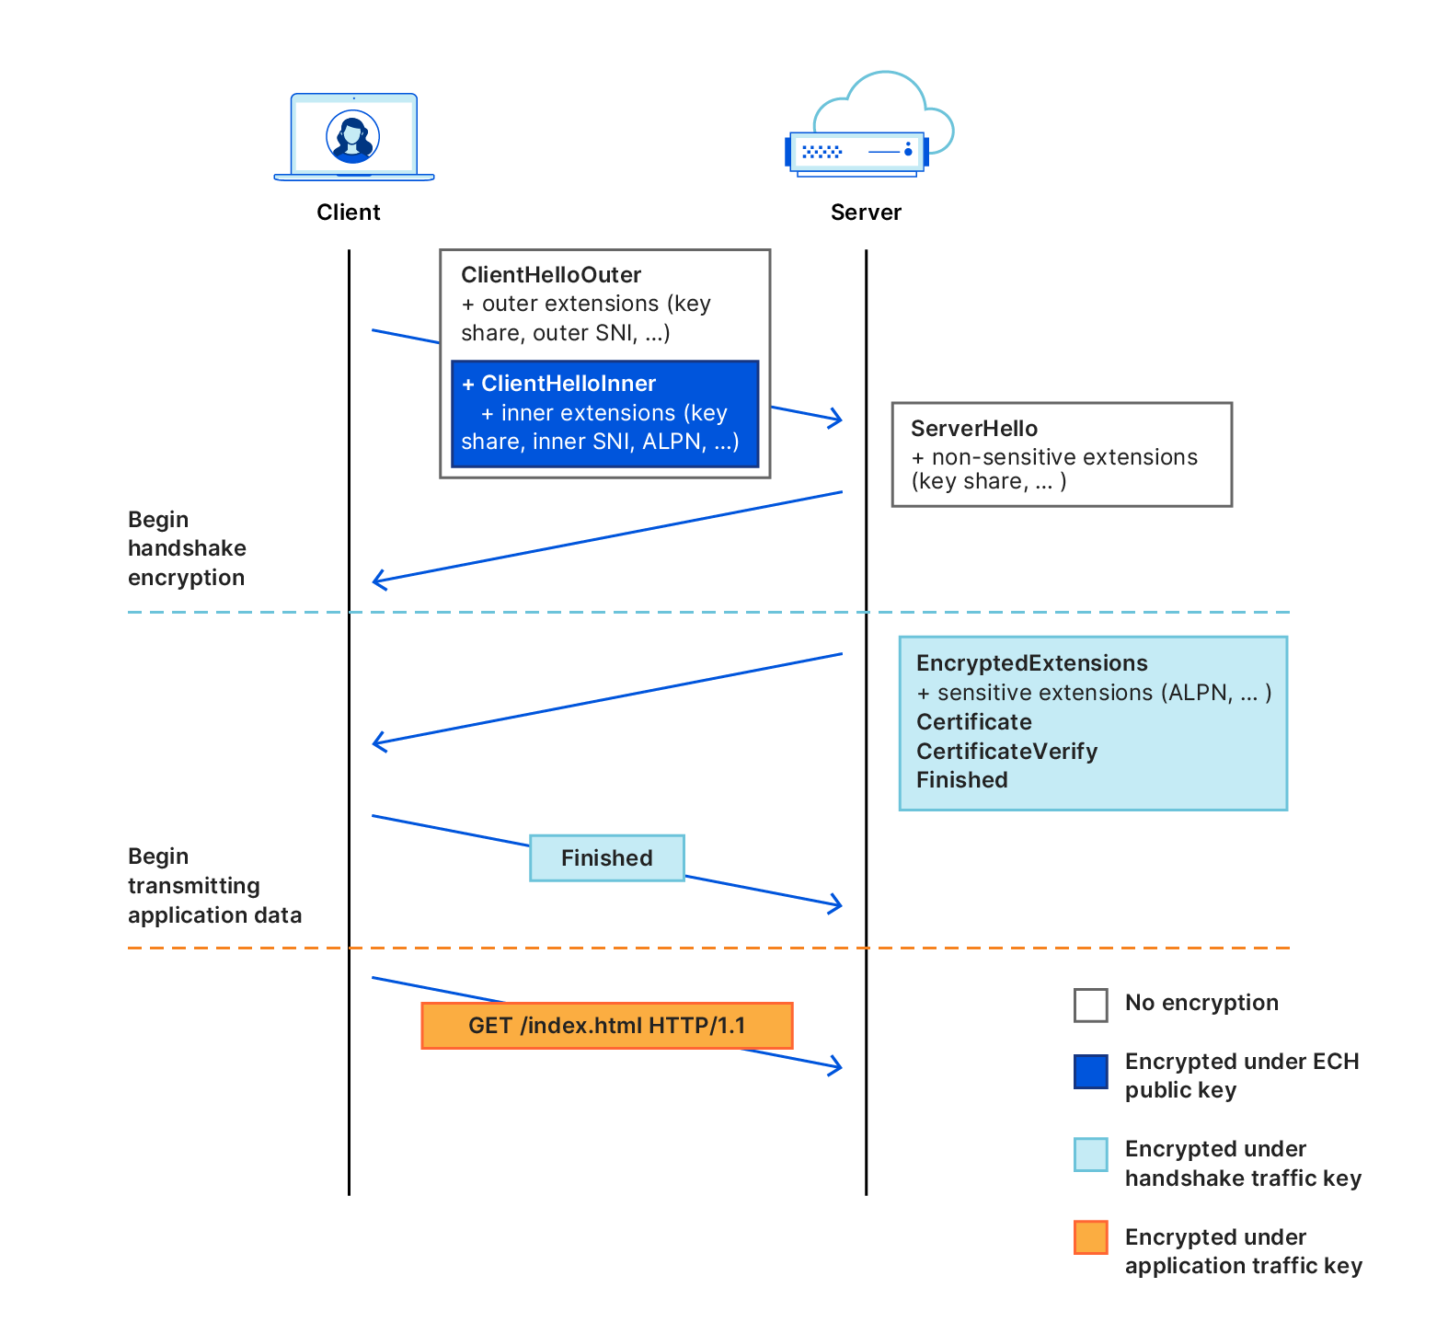
ECH Extension - Client Hello
ECH has 2 Client Hello:
Client Hello Outer
This is a full-fledged Client Hello message but with the bare minimum extensions and without any sensitive information
Client Hello Inner:
This is the intended Client Hello message that the client want the server to use
If the decryption with the Client Hello Inner fails, e.g outdated ECH config from the DNS record, the server continues with the Client Hello Outer only to provide the client with the correct ECH configuration and then the client aborts the connection!
Now the client should retry connecting with the correct server-provided ECH configuration

Slide 8
ECH Extension - HPKE
ECH uses the HPKE IETF draft for encrypting the sensitive extensions with a given public key.
This draft “...specifies an extensible framework for building public key encryption schemes suitable for a wide variety of applications”
And also “...ECH delegates all of the details of its handshake encryption mechanism to HPKE, resulting in a much simpler and easier-to-analyze specification”

Slide 9
ECH Extension - Future threats
ECH key management solves a number of issues like cache-poisoning and general key management
As it uses classical cryptography (as the rest of the TLS 1.3) ECH Extension is completely useless against an adversary in possession of a large-scale quantum computer.
To mitigate this threat, we can drop-in post-quantum cryptography in the ECH extension
A number of problems arise…

Slide 10
Post-quantum cryptography

Slide 11
Post-quantum cryptography
In response to the threat of quantum attacks, post-quantum cryptography emerged
NIST concluded the PQ process and 4 algorithms were selected for standardisation (3 standard drafts already published)
FIPS 203, Module-Lattice-Based Key-Encapsulation Mechanism Standard
FIPS 204, Module-Lattice-Based Digital Signature Standard
FIPS 205, Stateless Hash-Based Digital Signature Standard
In our case we need a Key Encapsulation Mechanism (KEM) to replace the ECC curve algorithms
Our only option is Kyber KEM - now known as ML-KEM

Slide 12
Post-quantum cryptography - ML-KEM
Post-quantum KEMs (and KEMs in general) introduce an asymmetry in the usual public key operations with ECDH.
All the details are presented in the work: PQ-HPKE: Post-Quantum Hybrid Public Key Encryption (eprint)
It provides overviews of the classical HPKE and with the PQ-HPKE. Also it provides description and schemes of a hybrid HPKE, that uses PQ and ECDH keys.

Slide 13
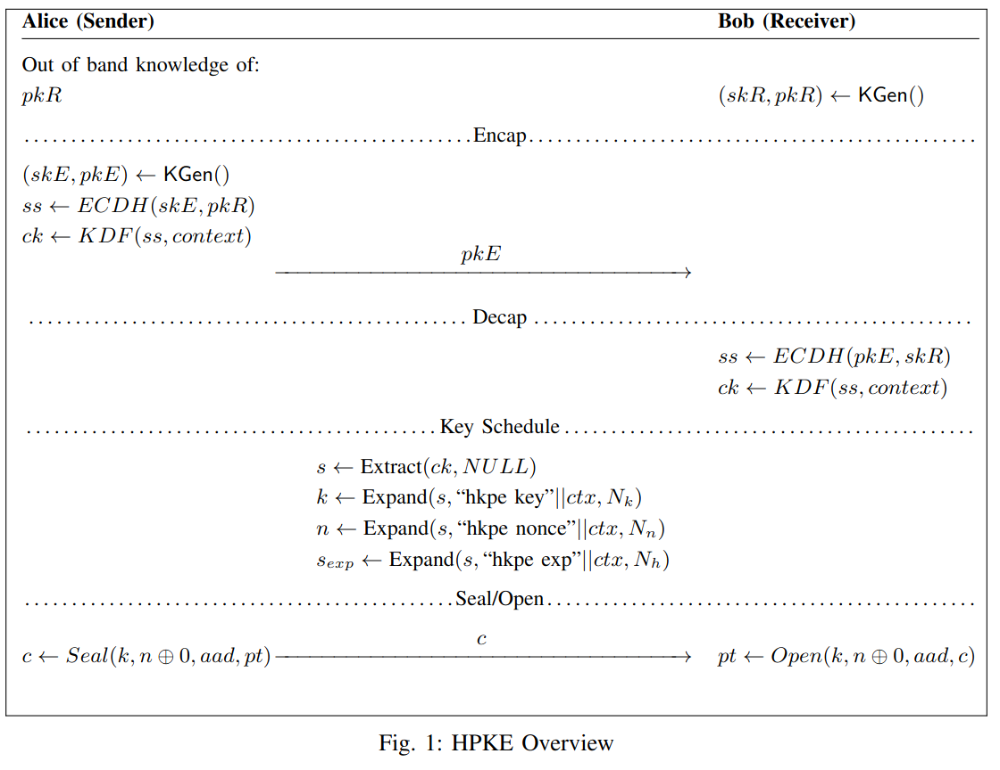
Post-quantum cryptography - HPKE
Classical HPKE overview

Slide 14
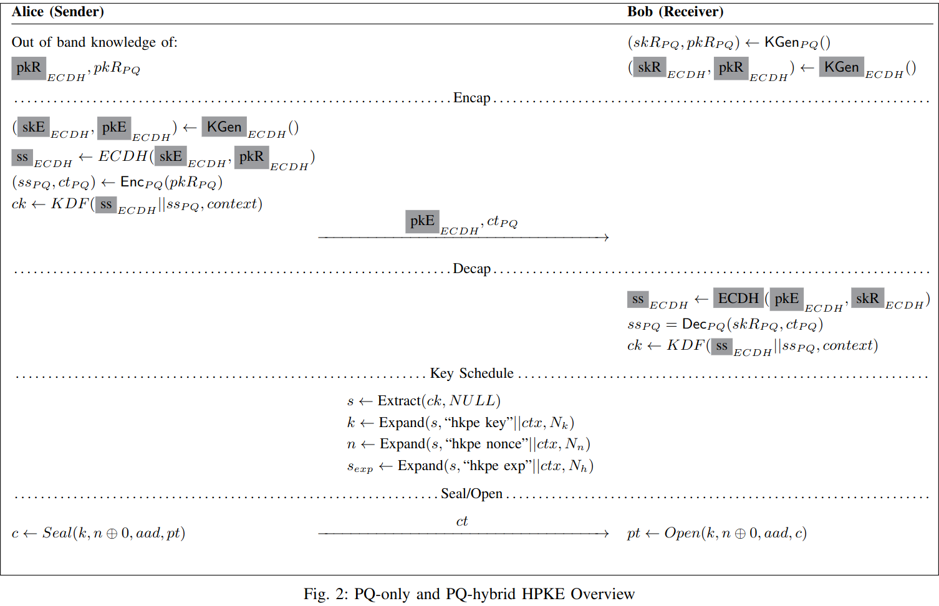
Post-quantum cryptography - HPKE
PQ-HPKE and PQ-hybrid HPKE overview

Slide 15
wolfSSL

Slide 16
wolfSSL
The implementation that we will use for “tweaking” the TLS 1.3 ECH extension into using PQ algorithms is wolfSSL.

Slide 17
wolfSSL - Roadmap
We have documented the complete roadmap available here:
https://github.com/GeorgeTasop/IETF118-PQ-ECH/blob/main/documentation/roadmap.md

